Slide 1

Addigy 6.0
Team Members: Bhanu Varma Rupa Kotha Product Owner: Jason Dettbarn Instructor: Masoud Sadjadi School of Computing and Information Sciences Florida International University
Final Presentation
Fall 2016
Notes:
7 seconds.
Greet your audience, thank them for attending your presentation, introduce yourself, introduce your project, introduce your team members, and quickly indicate what each of you did in a high-level manner, and put more emphasis on your part/contribution.

Slide 2
Project definition
Addigy is a Mobile Device management System.
The purpose of the project is to create a system able to remotely monitor and apply configurations to mobile devices(IOS and Android).
The project consists of two mobile applications (one for android and one for iOS) that communicate to a web service to report monitoring data and retrieve configurations.
It will also need a website component where an administrator can see the monitoring data and setup configurations.

Slide 3
Ionic Framework
Ionic is a complete open-source SDK for hybrid mobile app development. Built on top of AngularJS and Apache Cordova, Ionic provides tools and services for developing hybrid mobile apps using Web technologies like CSS, HTML5, and Sass.
Apps can be built with these Web technologies and then distributed through native app stores to be installed on devices by leveraging Cordova.

Slide 4
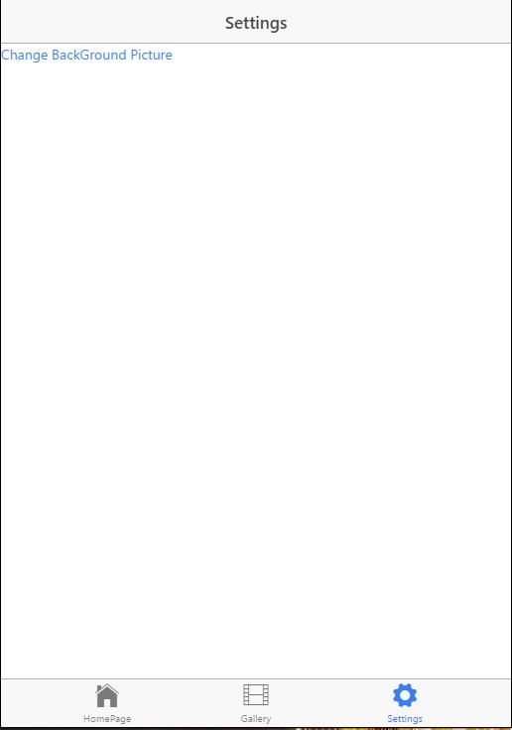
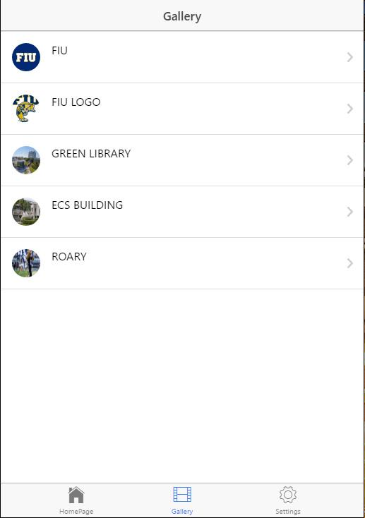
Screen shots

Slide 5
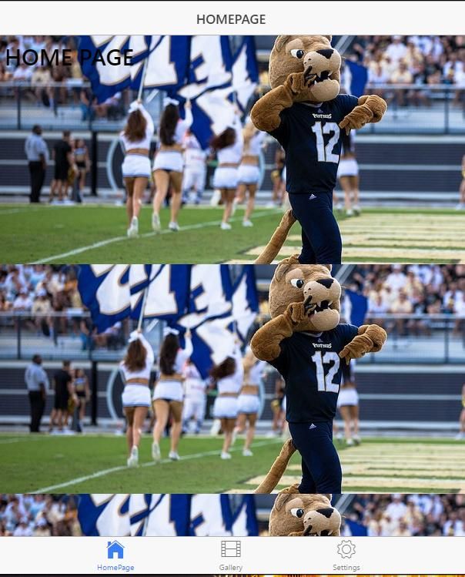
Screen shots

Slide 6
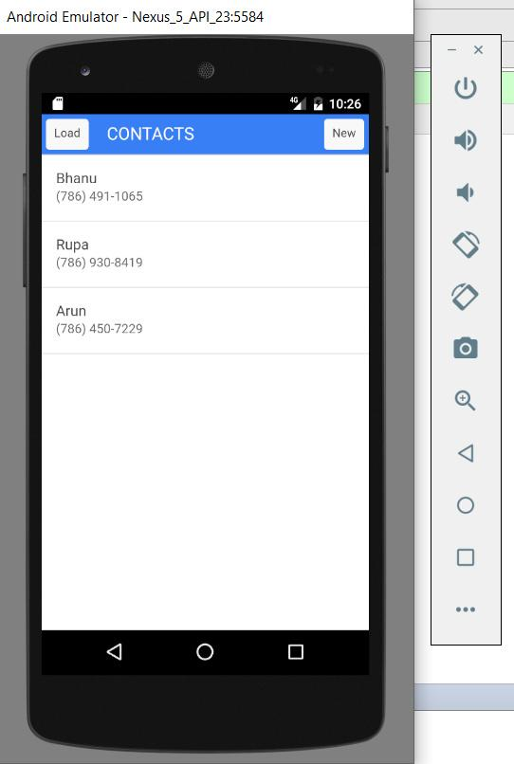
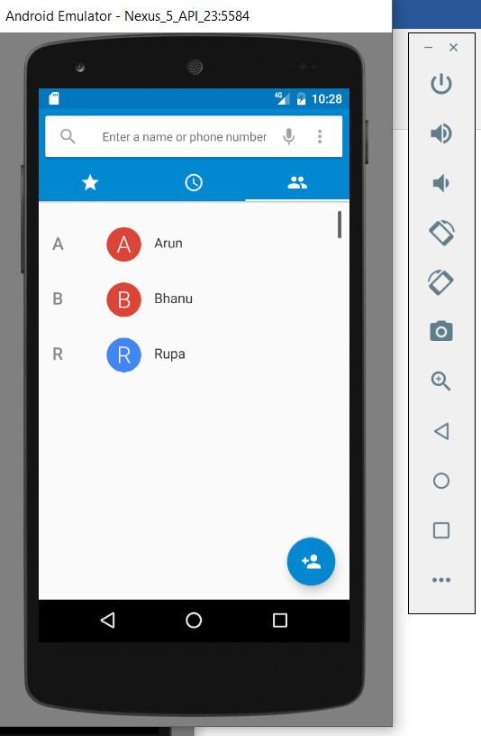
Screen shots
Notes:
10 seconds.
Introduce the problem that the whole project (in all versions) tackles with GIF or screenshot.

Slide 7
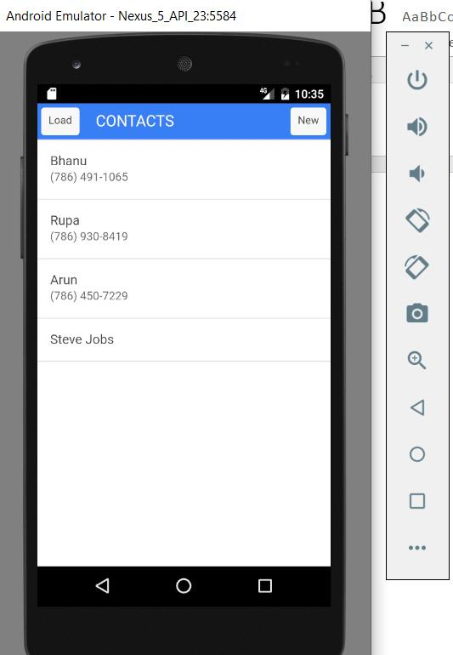
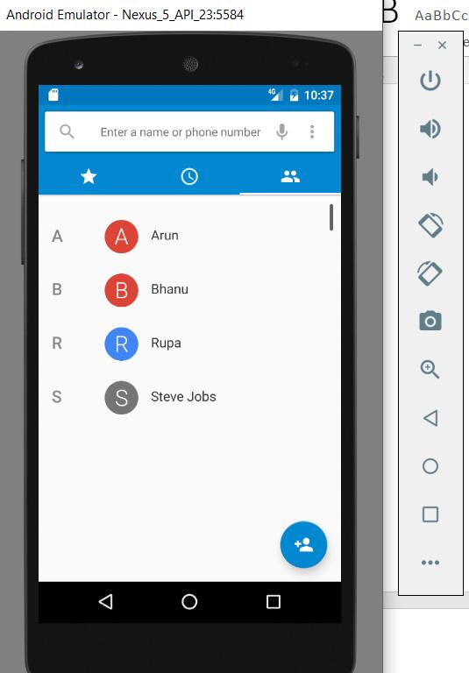
Screen shots
Notes:
20 seconds.
Introduce the problem that the your project (in new version) tackles with GIF or screenshot.

Slide 8
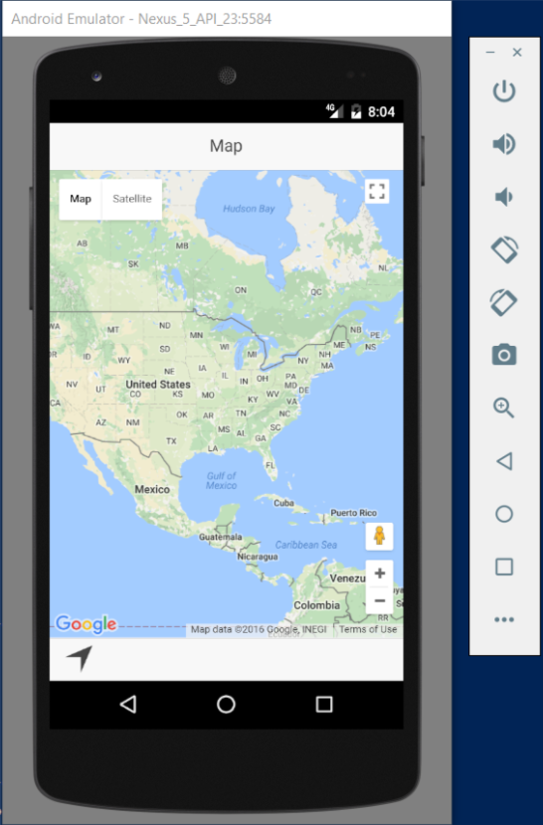
Screen shots

Slide 9
Requirements: Use Cases
The system that can remotely monitor the mobile devices.
The system that can apply required configurations to mobile devices.
The system consists of applications that work on mobile devices and communicate to a web service to report monitoring data and retrieve configurations.
The system administrator needs a website component to setup configurations and monitoring data.
Notes:
5 seconds
Show the Use Case Diagram for the whole project. Highlight your use cases.

Slide 10
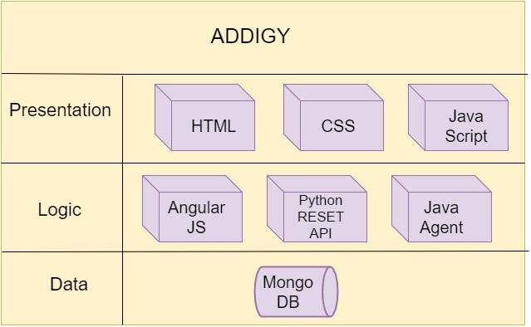
System Design: Architecture
Notes:
20 seconds
System design: Highlight the parts that you contributed to them.
1. System decomposition; identify the architecture patterns used
2. System deployment – h/w and s/w requirements

Slide 11
User Story #1
User Story #713: Preparation for the project:
Setup and preparation for the project
Acceptance Criteria:
Meetings with the product owner
Knowing the project previous work
Installing the software’s required
Notes:
60 seconds
The tile of user story
The most important user story you worked on it. You have to describe this one very well and be proud of that.
Please present and show the complexity of your work, code, algorithms, and technical challenges and technologies you have used. (you could use screenshot if you want. Visual presentations are better than text presentation)
Go into the details of the most important/significant tasks using bullet lists or visual graphs or state chart diagram
Sequence Diagram for this user story is mandatory (in another separate page if required)
Demo using screenshots or GIF (in another separate page if required)

Slide 12
User Story #2
User Story #715: Installing python and Django:
As a developer I need to install python and Django
Acceptance Criteria:
Installation of python 3.5.2
Installation of Django
Notes:
20 seconds
The tile of user story
Please present and show the complexity of your work, code, algorithms, and technical challenges and technologies you have used. (you could use screenshot if you want. Visual presentations are better than text presentation) - Go into the details of the most important/significant tasks using bullet lists or visual graphs or state chart diagram - Demo using screenshots or GIF (in another separate page if required)
Sequence Diagram for this user story is optional

Slide 13
User Story #3
User Story #717: Develop a sample Django application
Develop a sample Django application in which we can upload static files
Acceptance Criteria:
Creation of sample Django application.
Able to upload static files
Notes:
20 seconds
The tile of user story
Please present and show the complexity of your work, code, algorithms, and technical challenges and technologies you have used. (you could use screenshot if you want. Visual presentations are better than text presentation) - Go into the details of the most important/significant tasks using bullet lists or visual graphs or state chart diagram - Demo using screenshots or GIF (in another separate page if required)
Sequence Diagram for this user story is optional

Slide 14
User Story #4
User Story #719: Installing Django on Ubuntu server
As a developer I need to install a Django server on FIU Ubuntu server and run sample Django app that we have created from the Django server
Acceptance Criteria:
Login to the Django server.
Install Python pip and Django on the server.
Run sample Django App that we have created from the Django server
Notes:
20 seconds
The tile of user story
Please present and show the complexity of your work, code, algorithms, and technical challenges and technologies you have used. (you could use screenshot if you want. Visual presentations are better than text presentation) - Go into the details of the most important/significant tasks using bullet lists or visual graphs or state chart diagram - Demo using screenshots or GIF (in another separate page if required)
Sequence Diagram for this user story is optional

Slide 15
User Story #5
User Story #718: Learn HTML, CSS, JavaScript and AngularJS.
As a developer I need to learn HTML, CSS, JavaScript and AngularJS
Acceptance Criteria:
Learn HTML and CSS.
Learn JavaScript
Learn AngularJS.
Notes:
20 seconds
The tile of user story
Please present and show the complexity of your work, code, algorithms, and technical challenges and technologies you have used. (you could use screenshot if you want. Visual presentations are better than text presentation) - Go into the details of the most important/significant tasks using bullet lists or visual graphs or state chart diagram - Demo using screenshots or GIF (in another separate page if required)
Sequence Diagram for this user story is optional

Slide 16
User Story #6
User Story #726: Setting up Ionic Environment.
As a Developer I need to setup Ionic Environment.
Acceptance Criteria:
Install Node.js
Install cordova and ionic command line tools.
Install webstorm IDE.

Slide 17
User Story #7
User Story #720: Upload a picture to the server and set as wallpaper.
As a user I need to upload a picture to the server, the server generates a configuration file to set the file, changing wallpaper of the device.
Acceptance Criteria:
Upload an image to the server.

Slide 18
User Story #7
Server should generate a configuration file to set the picture as wallpaper of the device.
The device consumes the file, changing the wallpaper of the device.
Related Tasks:
​ Research on .mobileconfig files.

Slide 19
User Story #8
User Story #721: Fetch contacts from device contacts and add contact.
Develop an app that fetch and display the contacts from the mobile device contacts and add contact from the app.
Acceptance Criteria:
Fetch and display the contacts.
Add contact to the mobile device.

Slide 20
User Story #8
Related Tasks:
Install android studio.
Create an android virtual device.
Research on Ngcordova contacts plugin.

Slide 21
User Story #9
User Story #722: Integrate Google Maps into ionic app.
Develop a hybrid app that integrates google maps into the app and which works on android and ios platforms.
Acceptance Criteria:
Integrate google maps into the app.
App should run on android and IOS platforms.

Slide 22
User Story #9
Related Tasks:
Install android studio.
Create an android virtual device.
Research on Cordova google maps plugin.

Slide 23
Test Suites and Test Cases
Purpose: User should be able to set an image from the gallery as the wallpaper.
Precondition: User should go to the settings page and select ‘change background option’.
Input: User should select an image to set as background image.
Notes:
10 seconds
A description of verification process and Test Suites and Test Cases for one of the use cases.
1 One sunny day and one rainy day for the implemented use cases (one or more slides).
2 Automated test scripts for the implemented use cases (if any) (one or more slides).

Slide 24
Test Suites and Test Cases
Expected Result: The image should be set as the background image.
Actual Result: The image set as the background image.
Status: SUCCESS

Slide 25
Test Suites and Test Cases
Purpose: User pushes the load button and app fetches the contacts from the device phonebook.
Precondition: User should open the Contacts app.
Input: User pushes the load button.
Expected Result: The app should load contacts from the device phonebook.
Actual Result: App loads the contacts
Status: SUCCESS

Slide 26
Test Suites and Test Cases
Purpose: User Opens the Ionic maps app and app displays the maps from the google maps API.
Precondition: User should open the Ionic maps app.
Input: User opens the app.
Expected Result: The app should display maps.
Actual Result: App displays the maps.
Status: SUCCESS

Slide 27
Summary
Mobile phones have become one of the most valuable assets nowadays. IT intelligence at scale provides some sort of intelligence to assist when taking decisions regarding these assets.
My contribution to Addigy’s System.
Learned to build hybrid mobile applications using Ionic framework.
Application that fetches images from gallery and setting image as the wallpaper.
Notes:
10 seconds
Summarize your contribution, mention your effort for Scrum, Mingle, Github, Google Drive Documentation and minutes
Include your contact information
Ask if anyone has any questions for you.
Thank your audience

Slide 28
Summary
Application that fetches contacts from the device phonebook and adds contacts to the device phone book.
Application that integrates google maps to the ionic application.

Slide 29








contact information
Rupa Kotha Bhanu Boredha
Email: rkoth002@fiu.edu Email: bbore006@fiu.edu

Slide 30
Thank You!

